Slide 1
Tableau-Formatting visualization and Analysis

Slide 2
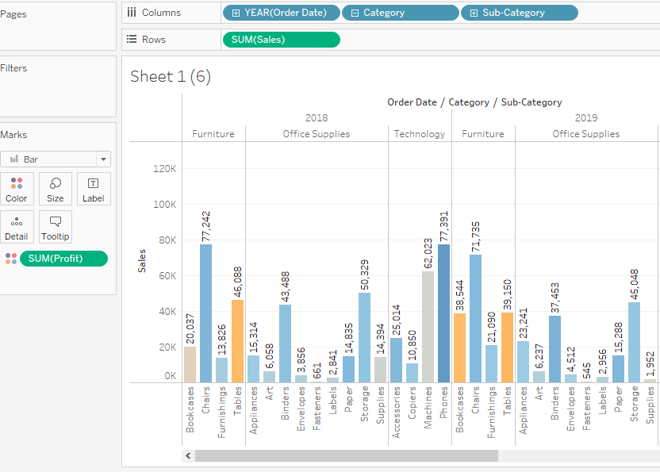
1.Find the profit and sales for each subcategory of every type of product.
Sales and profit of
each subcategory in year
2018 and 2019

Slide 3
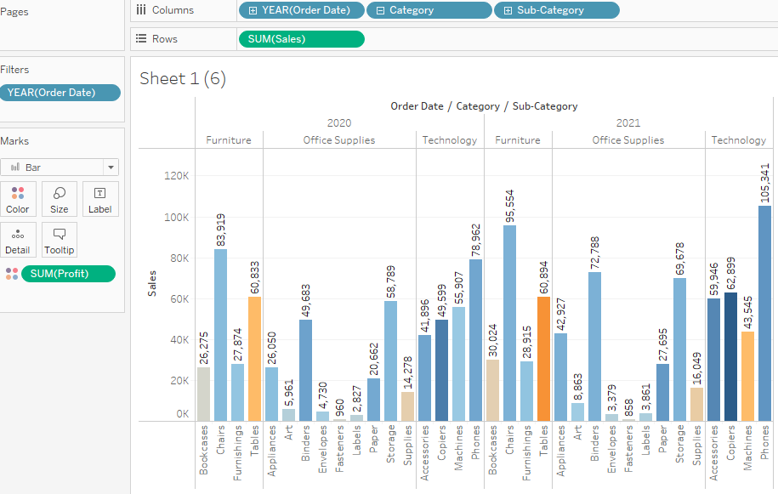
Sales and profit of each subcategory in year 2020 and 2021

Slide 4
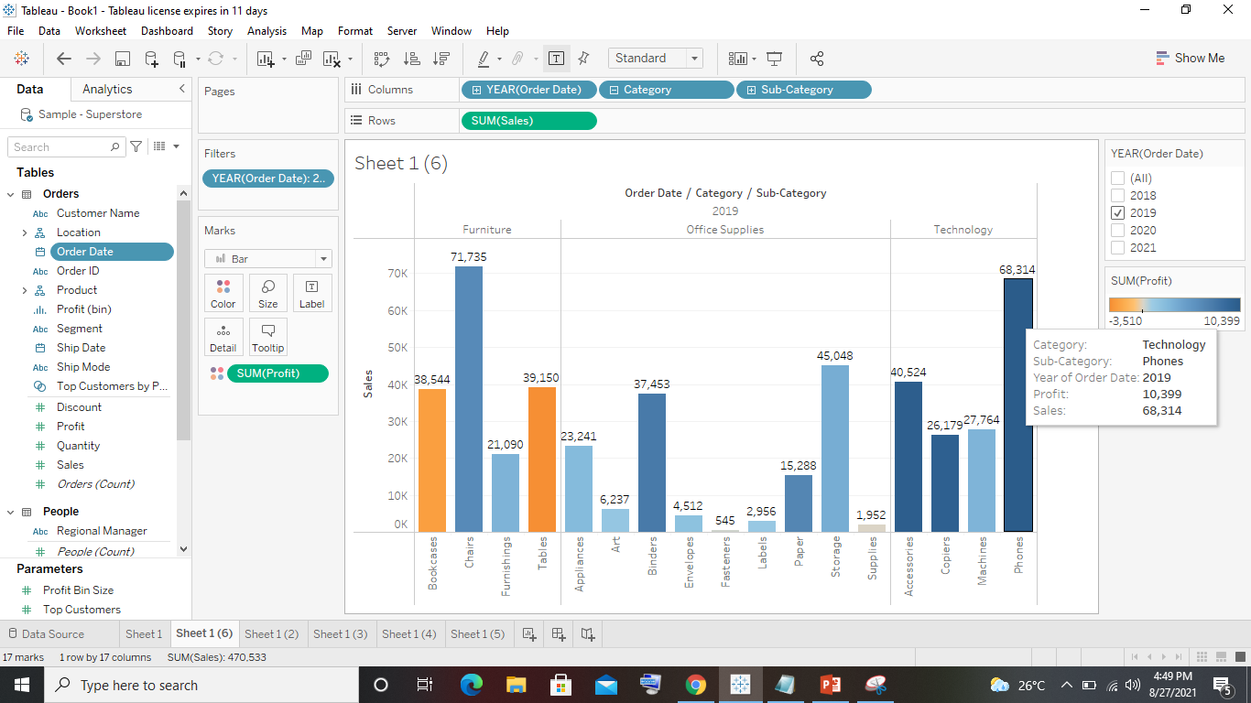
2. Which subcategory has highest profit in the year 2019.
Highest profit
2019 in category of
Technology its phones
With profit of 10,399

Slide 5
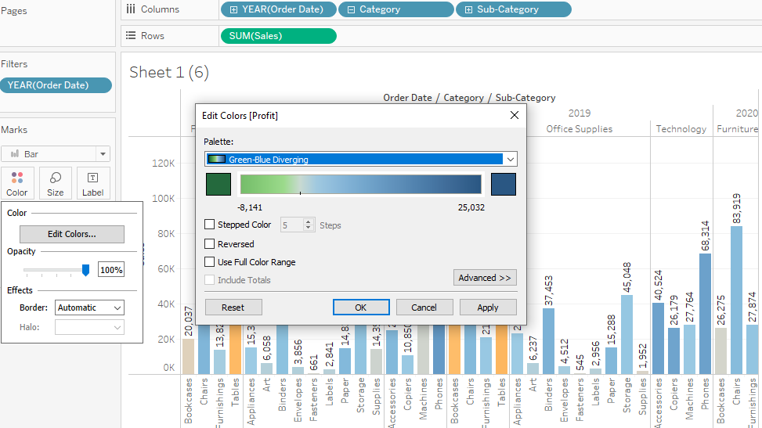
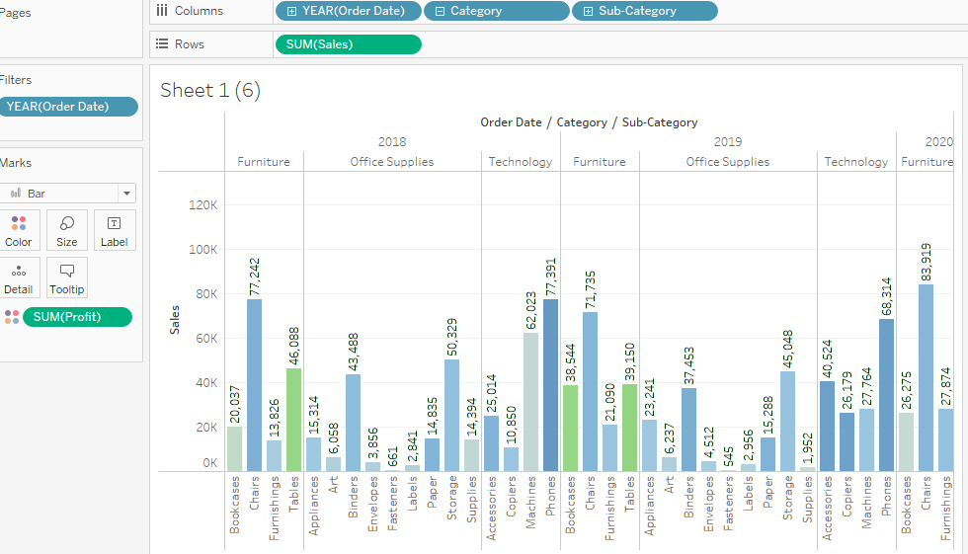
3. In case 1, change the color of the view from the Marks card.

Slide 6
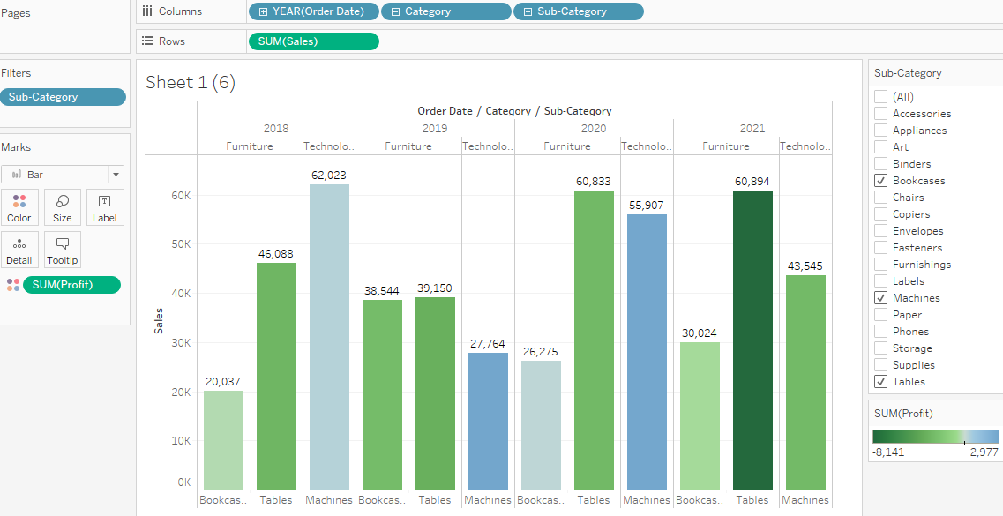
4. In the view, in the Sub-Category filter card, clear all of the check boxes except Bookcases, Machines, and Tables to have closer look on each value.

Slide 7
5. Find out the key insights about in which year bookcases and machines were profitable and unprofitable.
Bookcases
Profitable 2020 212
Unprofitable 2019 2755
Machines
Profitable 2019 2977
Unprofitable 2021 2869

Slide 8
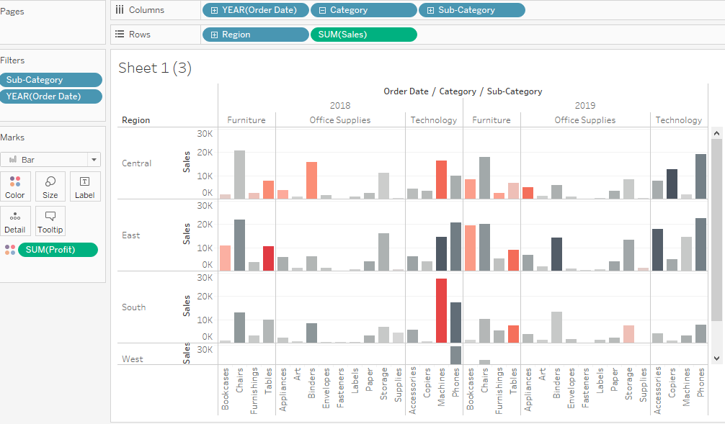
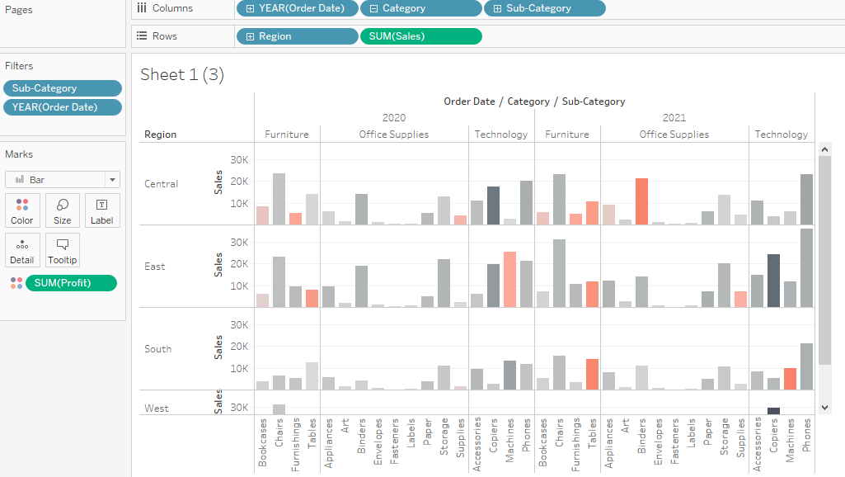
6. Show the sales region wise for every subcategory and category and every year.

Slide 9
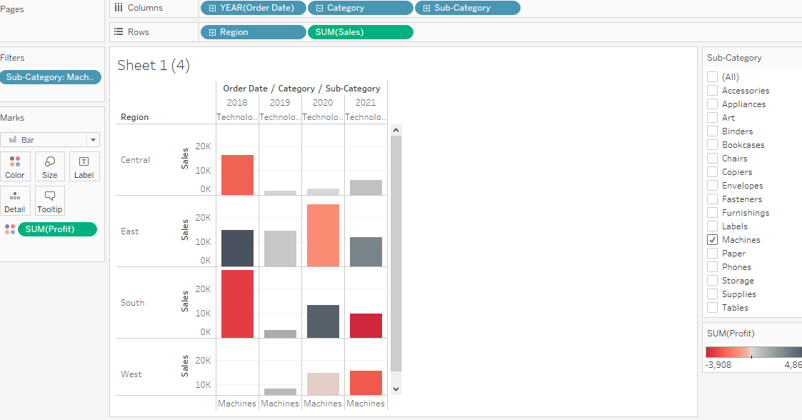
7. Duplicate your worksheet and check sales region vise for Machine type subcategory.

Slide 10
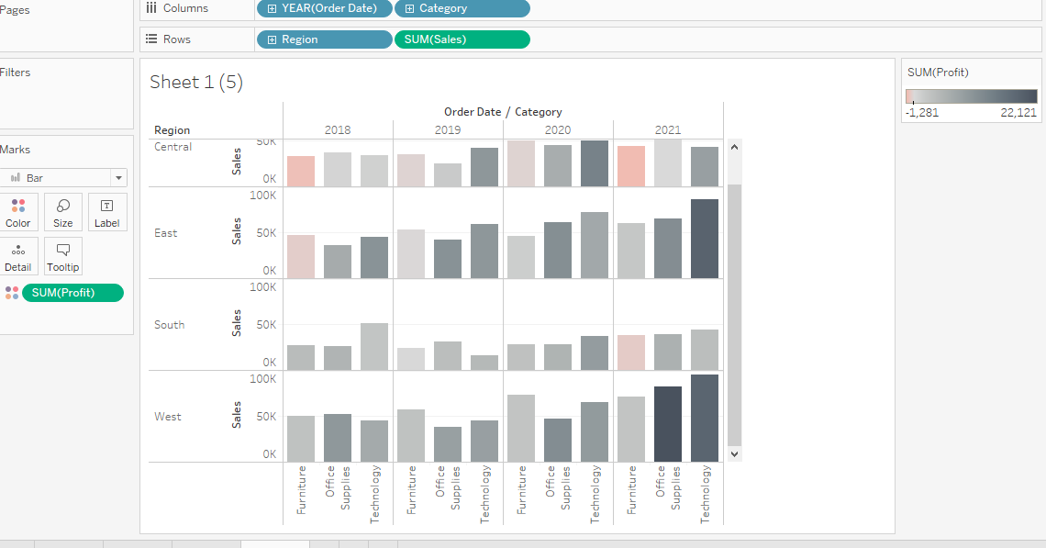
8. In which region you are reporting a higher negative profit overall than in your other regions.
Based on the color scale its been predicted that central has more negative profit than overall than other regions.

Slide 11
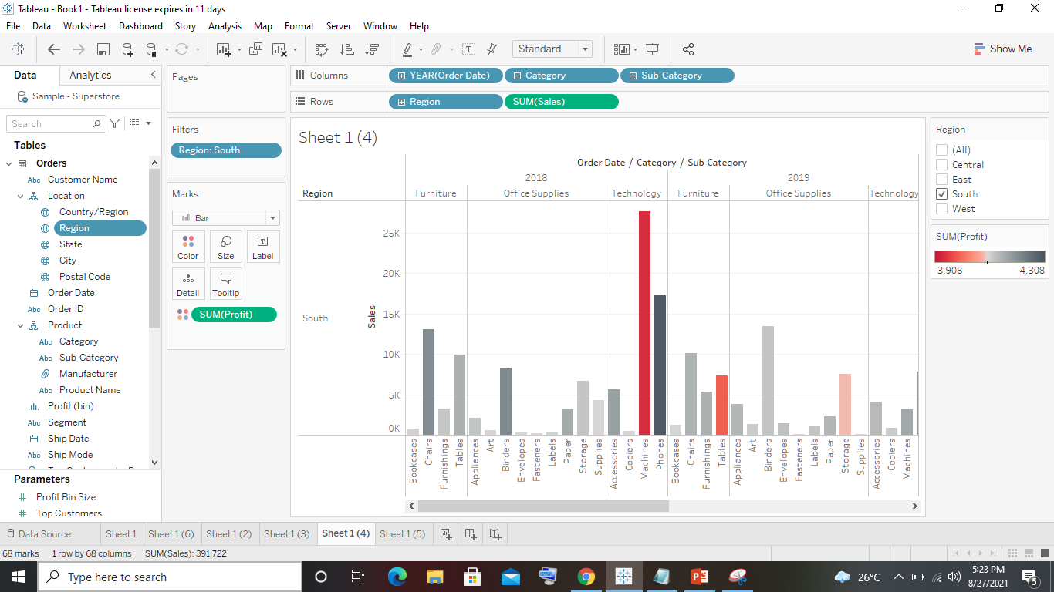
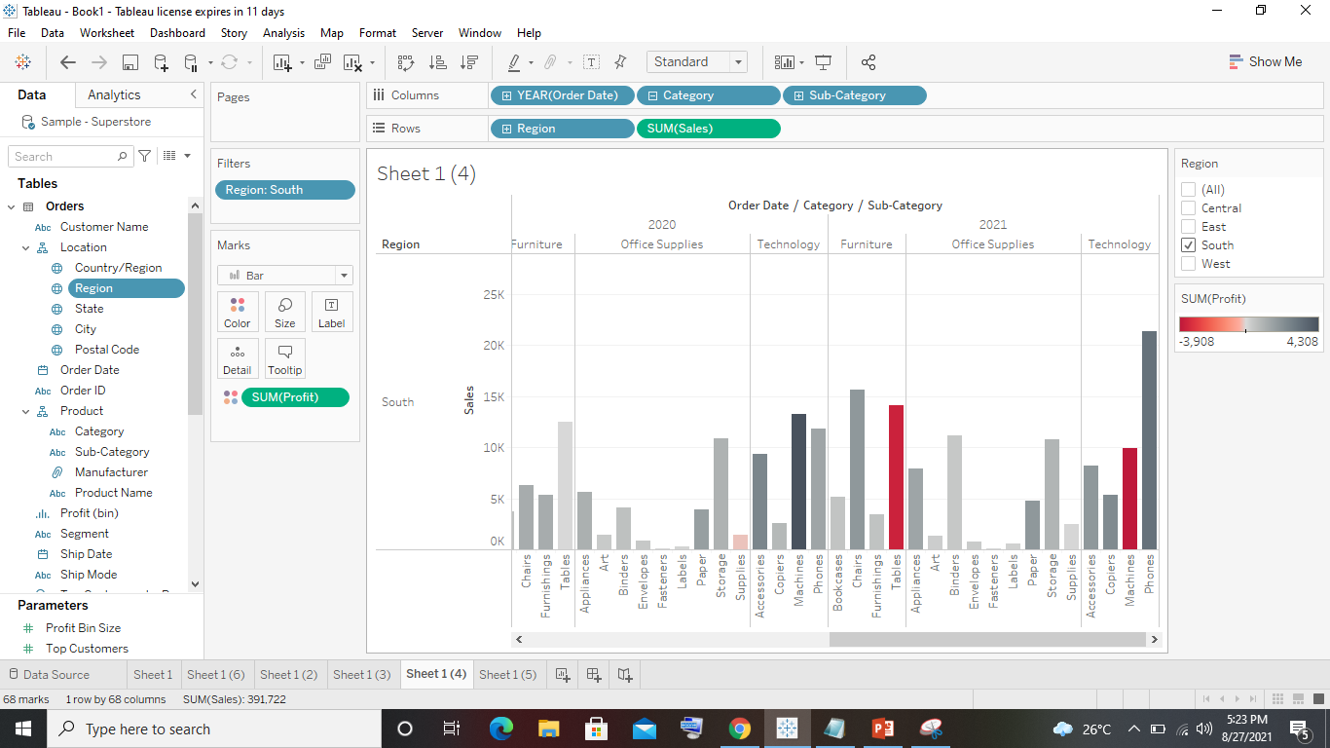
9. Show your view for Sales in the South for all subcategory.

Slide 12
10. Which subcategory has highest overall negative sales in the south region.
The subcategory with overall negative sales is fasteners with sales of only 105 in the year 2020
11. Take some decisions to improve sales in the south.
When compared with the years 2018 and 2019 there is gradual increase in sales of all the categories in years 2020 and 2021
As there is increase in sales in 2020 and 2021 the highest sales are for the category technology with sales of 37022 in 2020 and 44,828 in 2021 so there is no need to focus on technology.
The sales of furniture's category is little low when compared to office supplies by this we need to focus on both the categories to improve the sales in the future.

